Slide 1
Libraries and Literacy: Making Connections
Jennifer Peters
Community Engagement Administrator
Texas State Library and Archives Commission

Slide 2
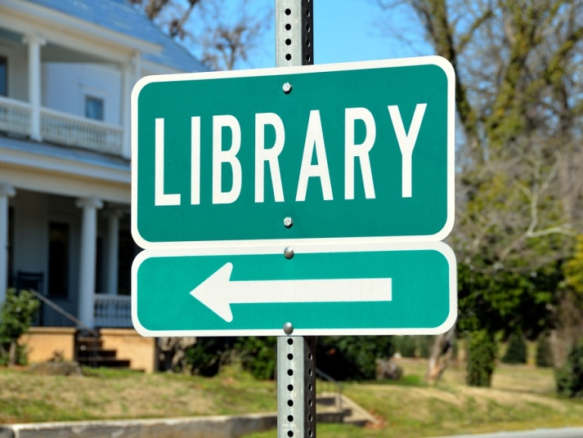
Public Library* Adult Education and Literacy (AEL) Expansion Project
Part of TRAIN TEX Project
Goal: Expand library engagement with local AEL providers
* More than just public libraries!

Slide 3
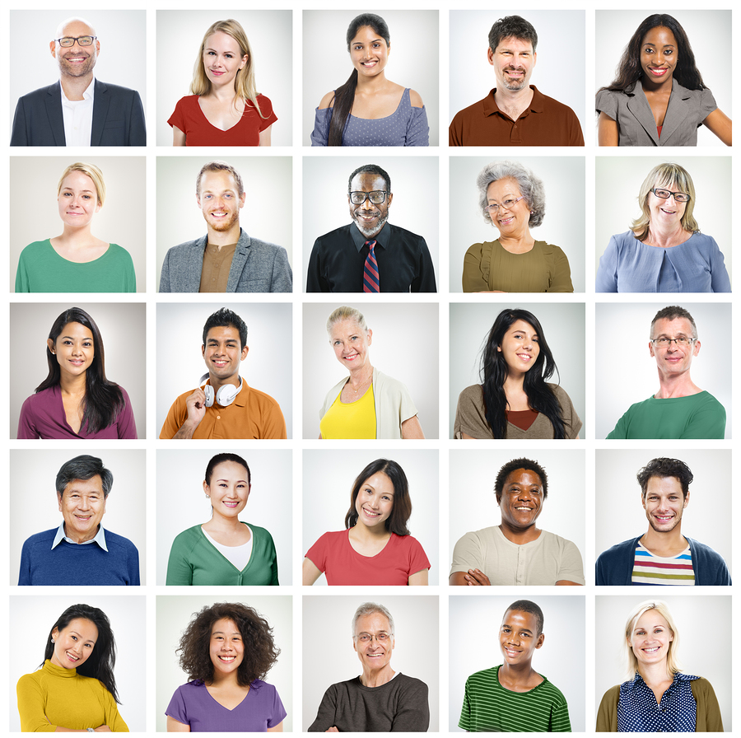
Needs Assessment Survey
May 16-31, 2016
Shared widely with library and literacy community

Slide 4
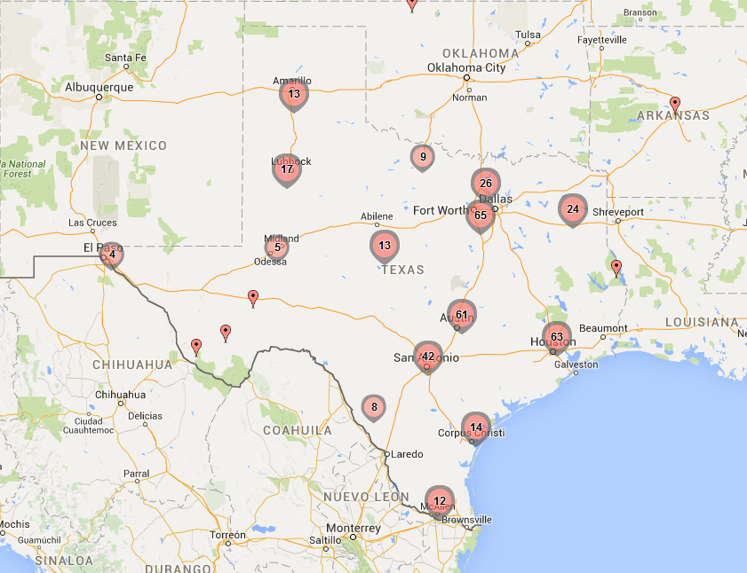
Who Responded?
407 responses (289 complete)
225+ separate organizations
81% describe themselves as small to medium
53.7% public libraries
12.2% community college libraries
15.2% academic libraries
7.8% literacy providers
11.1 % other
More information on locations here

Slide 5
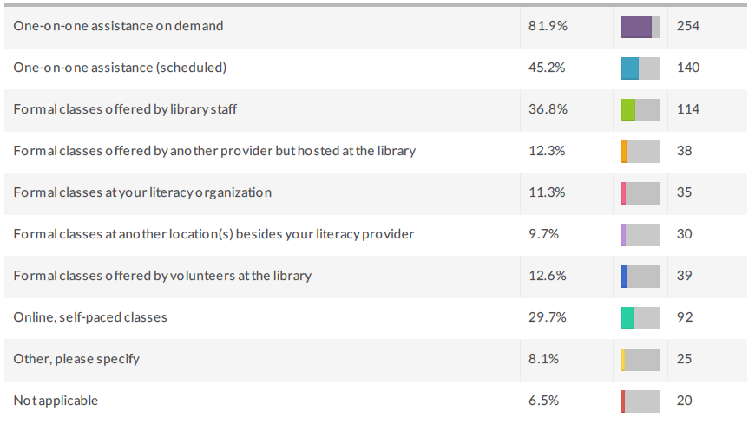
What We Learned
What kind of digital literacy training do you provide? Select all that apply.

Slide 6
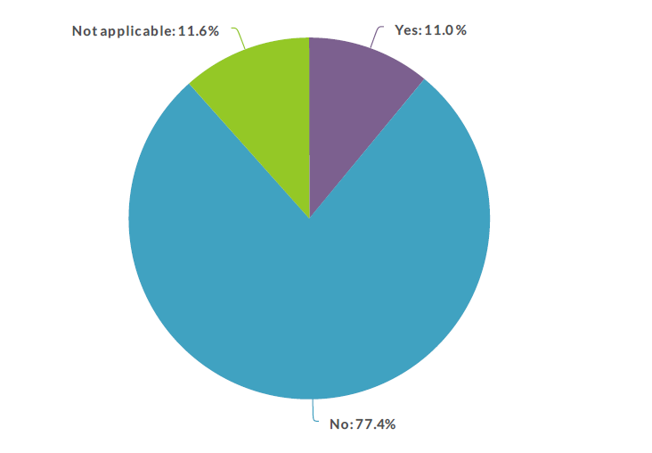
What We Learned
Do you use an existing digital literacy curriculum?

Slide 7
What We Learned

Slide 8
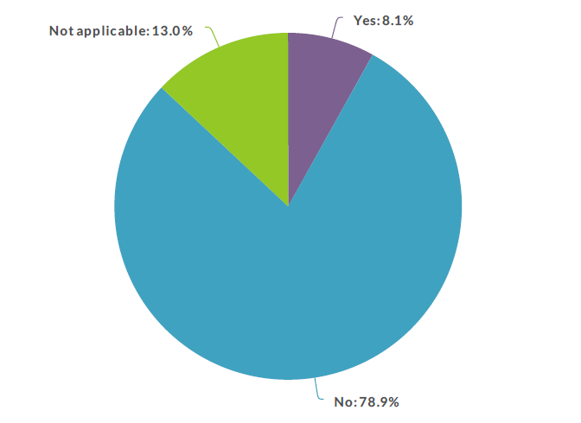
What We Learned
Do you use a pre-assessment tool on your patrons/users before providing services?

Slide 9
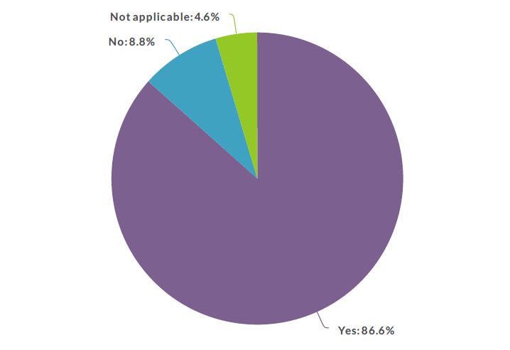
What We Learned
Are there unmet digital literacy needs in your community?

Slide 10
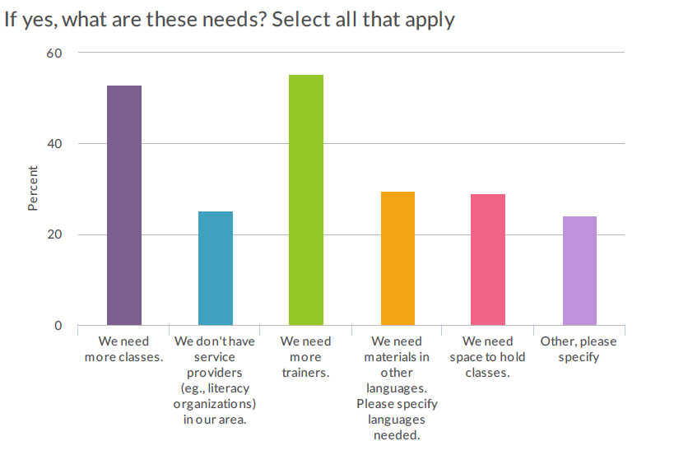
What We Learned

Slide 11
What We Learned

Slide 12
Other, Please Specify
Free simple curriculum
Funding
More computers for the public to use
Access to technology
More staff familiar with technology
Need more trainers
Nothing exists, we need help.
Time, money, space, people
Volunteer tutors
Digital Literacy classes
More devices to demonstrate curriculum
Connectivity for learners outside of centers
Better publicity

Slide 13
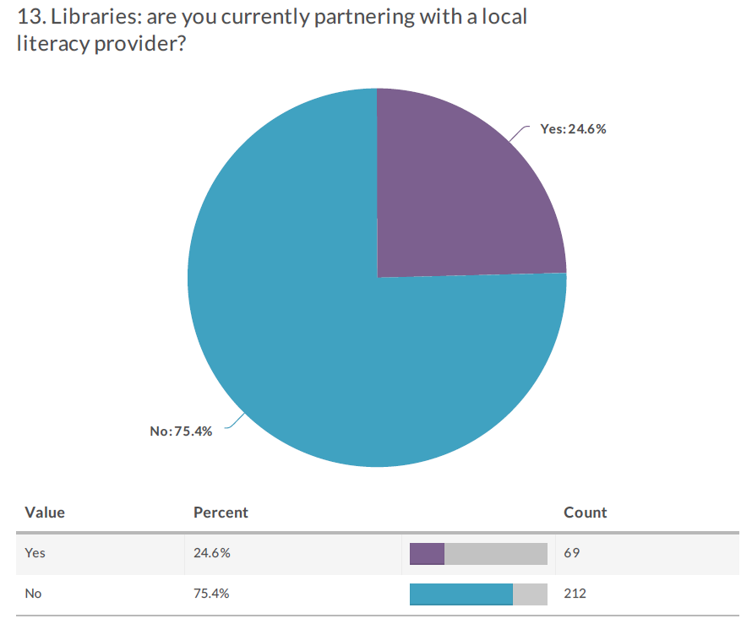
What We Learned

Slide 14
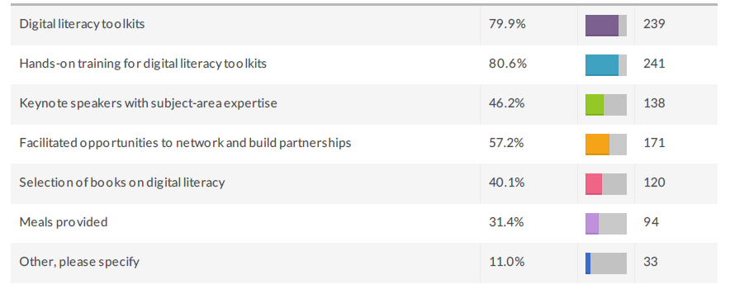
What We Learned
What would make you want to attend a day-long regional workshop on digital literacy and partnerships?

Slide 15
Other, Please Specify
Follow-up training
Close proximity
Low cost
How to gain funding
Location
Materials in Spanish
STEPS ON HOW TO GET THIS GOING
Someone to work in the library while I am in this training
Grants for digital literacy
Help with travel
Software, flashdrive, computer giveaways

Slide 16
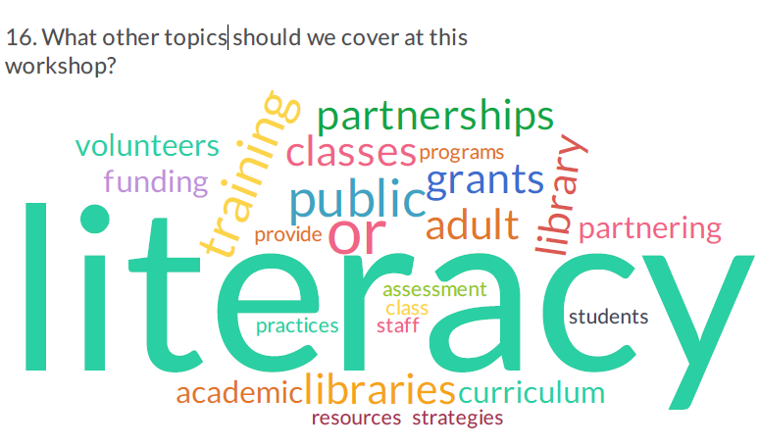
What We Learned
Highlights of Other Topics to cover at a workshop

Slide 17
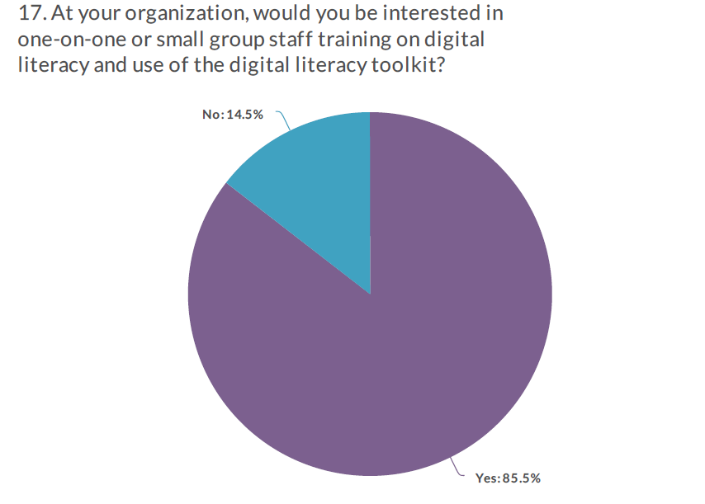
What We Learned

Slide 18
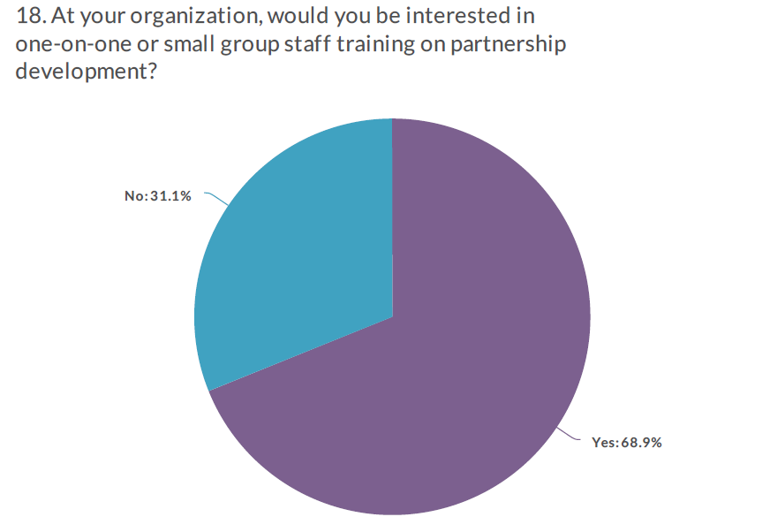
What We Learned

Slide 19
What’s Next
Digital Literacy Toolkit, in translation
Digital Literacy webpage
Regional Training workshops
One-on-one coaching
More?

Slide 20
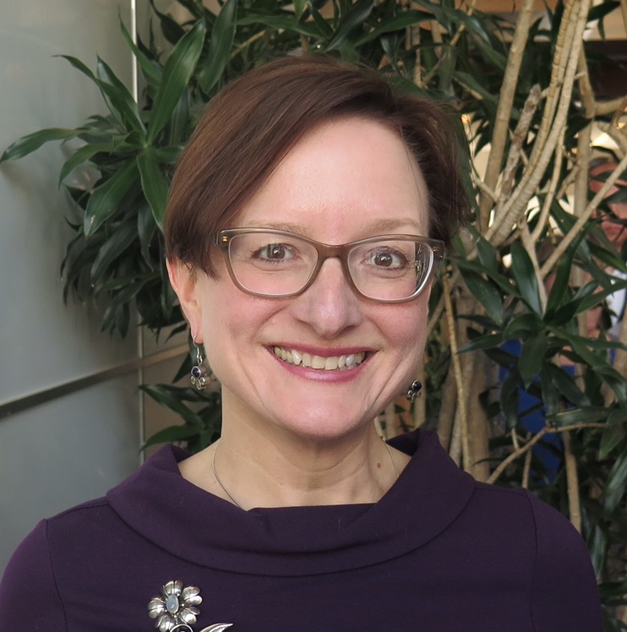
Discussion/Questions?
Jennifer Peters
Community Engagement Administrator
jpeters@tsl.texas.gov
512-463-2214

